Slide 1
5 – Scenarios
Interactive Dashboard

Slide 2
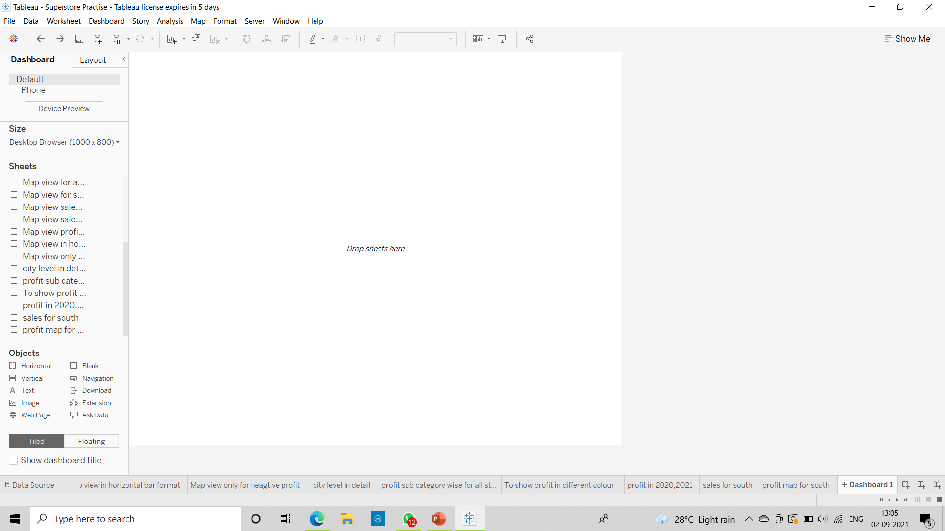
Build Dashboard to show some insights.

Slide 3
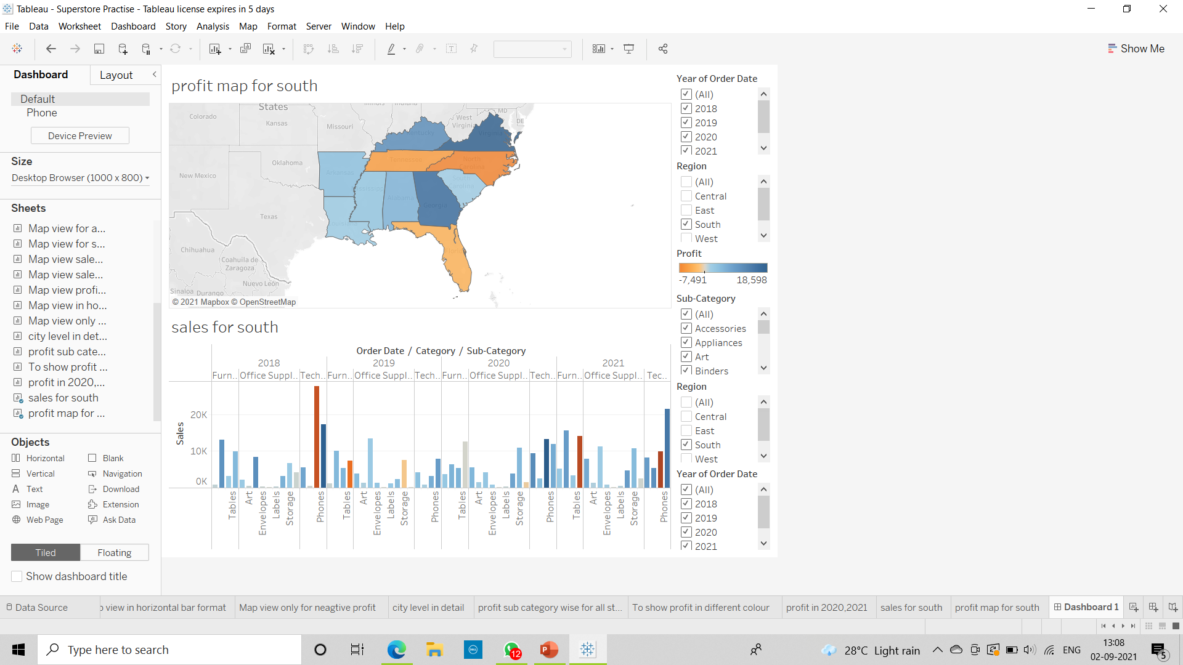
2) Arrange Your Dashboard.

Slide 4
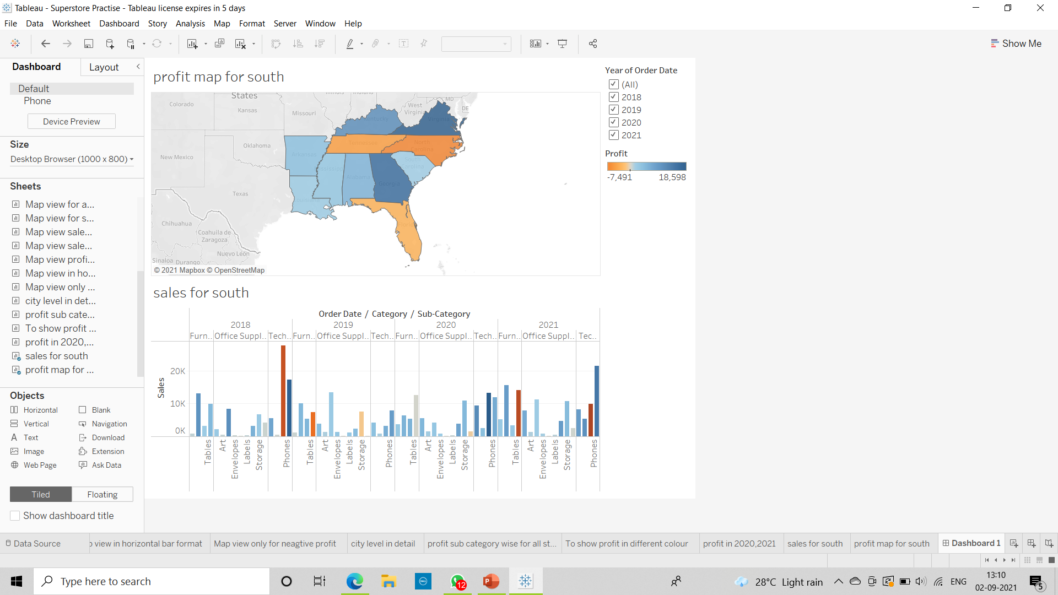
3) Remove the subcategory filter option to vacate the space.

Slide 5
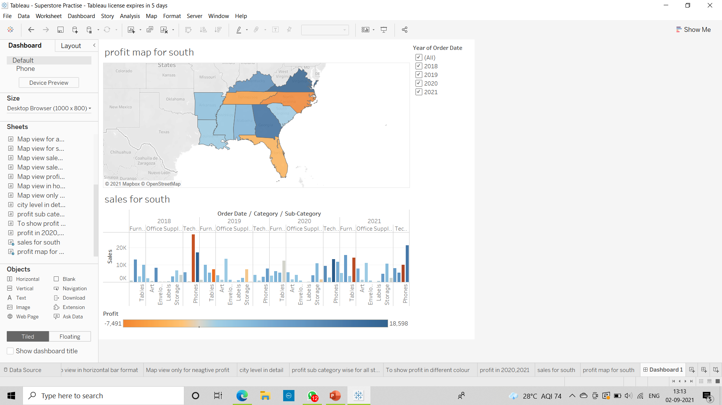
4) Select Profit color legend and drag it below Sales in the South.

Slide 6
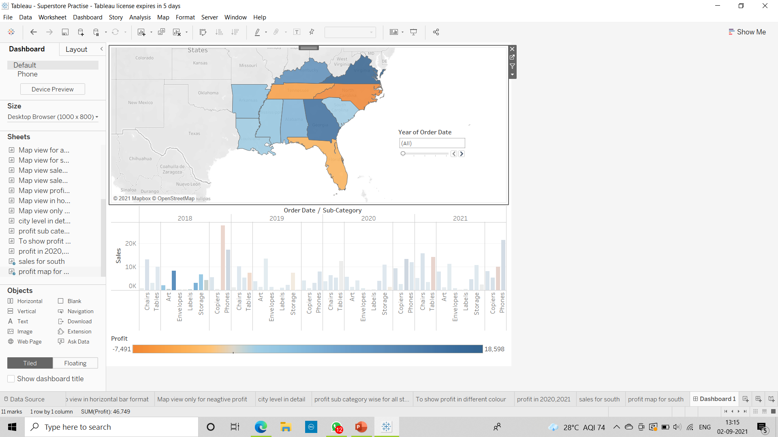
5) Remove the year of order filter option to vacate the space add a slicer

Slide 7
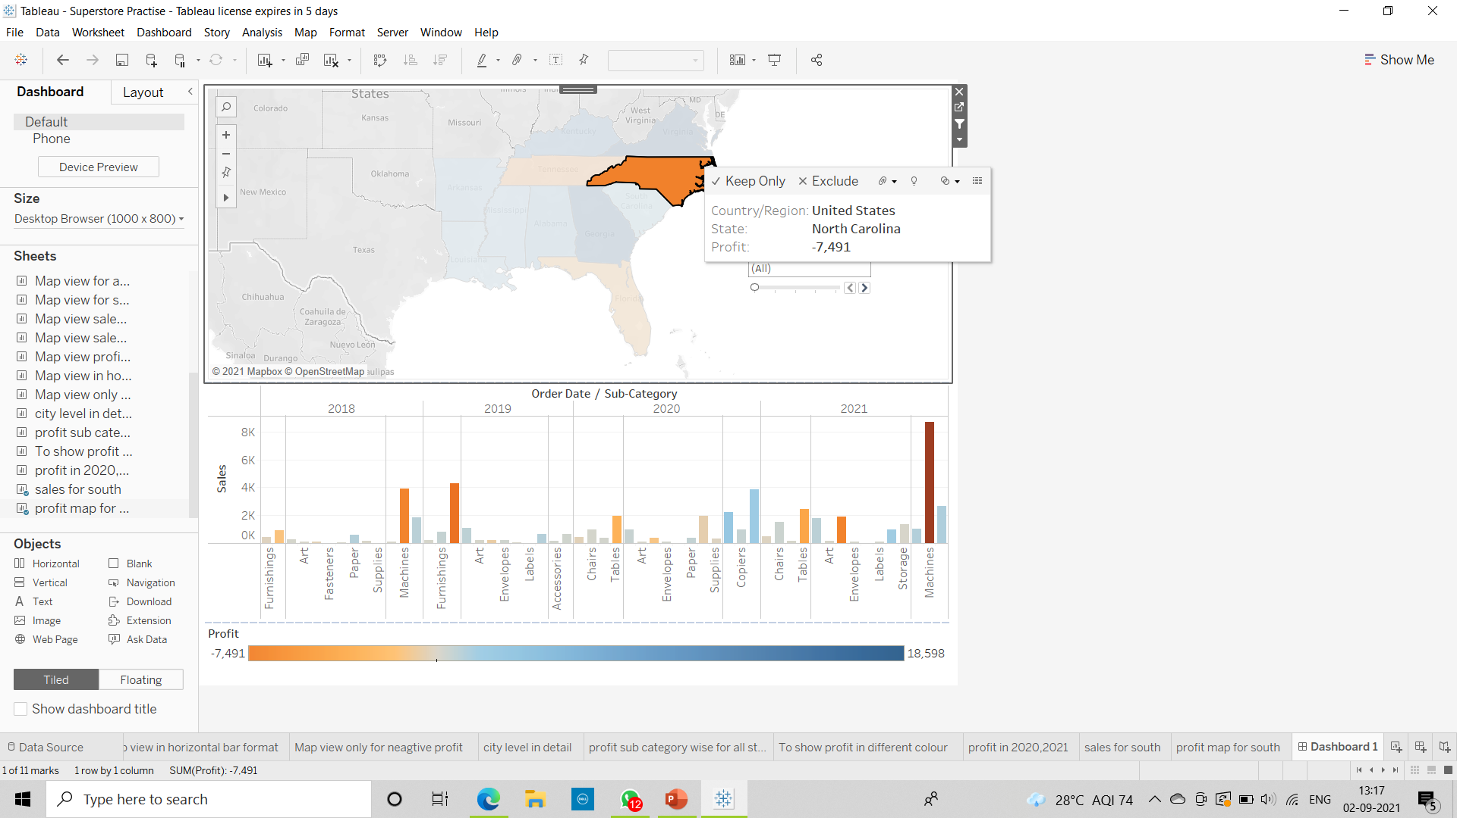
6) Make your dashboard interactive.

Slide 8
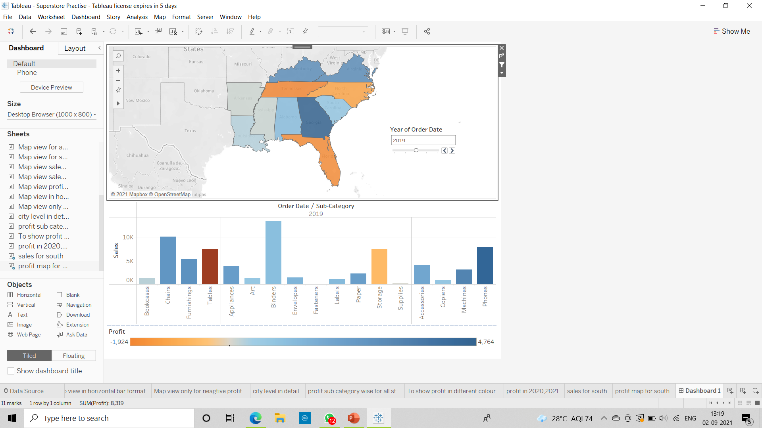
7)Make the order date file applicable for sales in the south visual as well.

Slide 9
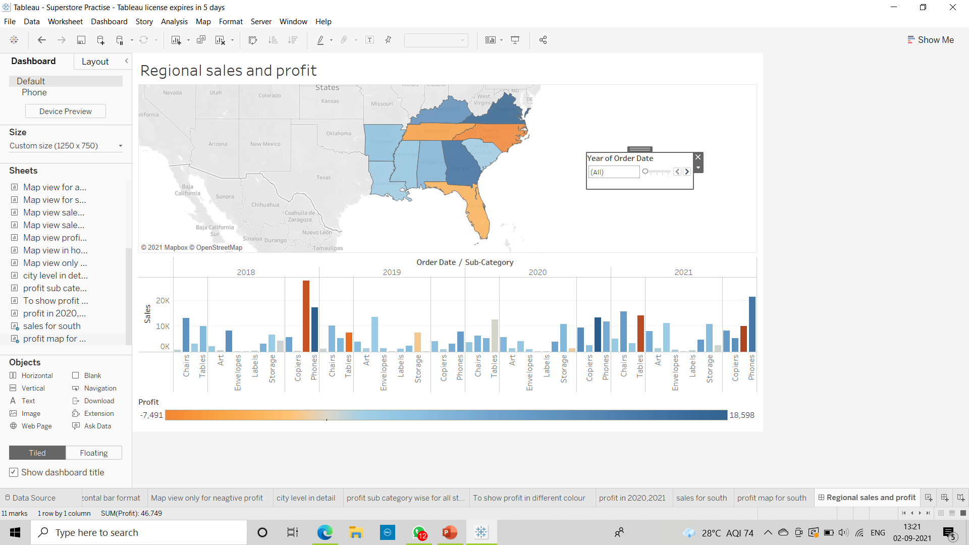
8)Rename your dashboard and save as Regional Sales and Profit.

